Slide 1
UNIT-I
KCS-601
SOFTWARE ENGINEERING
PART-I
Software Engineering

Slide 2
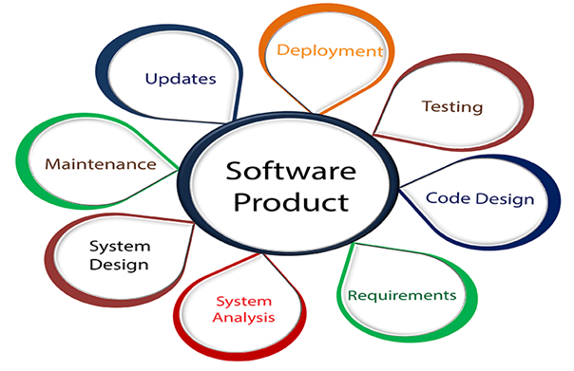
SOFTWARE & ENGINEERING
Software: The software is a collection of integrated programs.
Engineering: Engineering is the application of scientific and practical knowledge to invent, design, build, maintain, and improve frameworks, processes, etc.

Slide 3
Software Engineering
Software engineering (SE) is the application of a systematic, disciplined, quantifiable approach to the design, development, operation, and maintenance of Software, and the study of these approaches; that is, the application of engineering to Software.
Stephen Schach defined the same as “A discipline whose aim is the production of quality software, software that is delivered on time, within budget, and that satisfies its requirements”.

Slide 4
Classification Of Software
Custom Software
For a specific customer
Generic Software
Sold on open market
Often called
COTS (Commercial Off The Shelf)
Shrink-wrapped
Embedded Software
Built into hardware
Hard to change

Slide 5
Types Of Software
System Software-This Software includes the operating system and all utilities that enable the computer to function.
Application Software-These consist of programs that do real work for users. For example, word processors, spreadsheets, and database management systems fall under the category of applications Software.

Slide 6
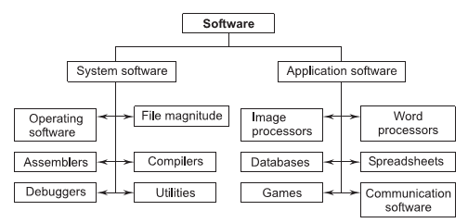
Types Of Software

Slide 7
Software Myth
It is Defined in these categories-
Management Perspectives
Customer Perspectives
Practitioners (Developer) Perspectives

Slide 8
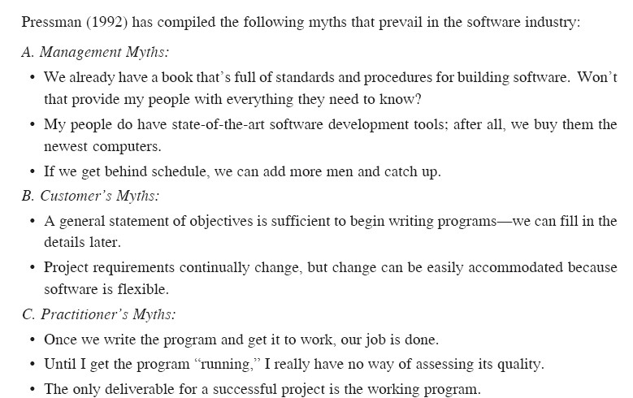

Slide 9
Software Components
Off-the Shelf Components: Existing software that can be acquired from a third party(Developed internally for past project )
Full Experience Components: Existing specifications,design,code or test data developed for past project
Partial Experience Components: Existing specifications,design,code or test data developed for past project but will require substantial modification.
New Components: Components that must be built by the software team

Slide 10
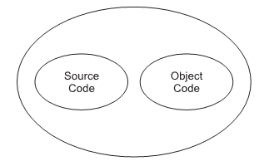
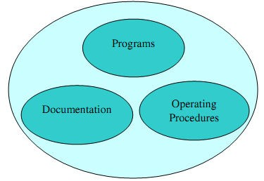
Software Components
Program=Source code + object code
Software=Program + Documentation + Operating Procedures

Slide 11
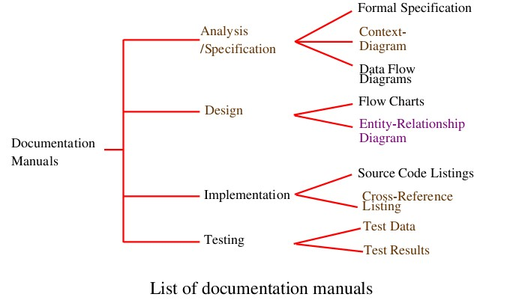
Documentation consists of different types of manuals are:

Slide 12
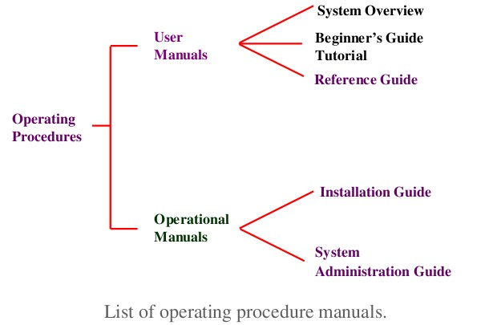
Documentation consists of different types of manuals are:

Slide 13
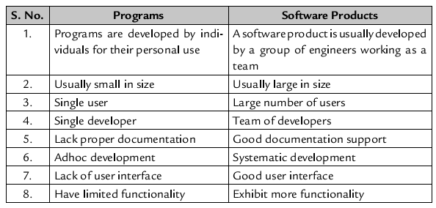
Software Components

Slide 14
Importance of Software
Computer Software has become a driving force-
It is the engine that drives business decision making.
It serves as the basis for modern scientific
investigation and engineering problem-solving.
It is embedded in all kinds of systems, such as transportation, medical, telecommunications, military, industrial processes, entertainment, office products, etc.

Slide 15
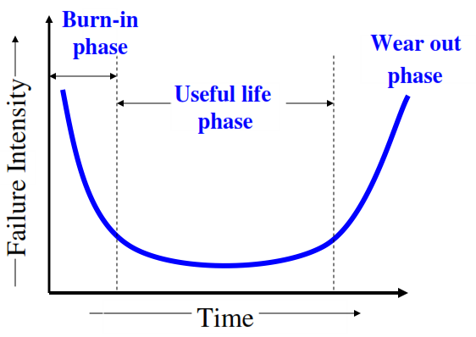
Software Characteristics
1. Software does not wear out

Slide 16
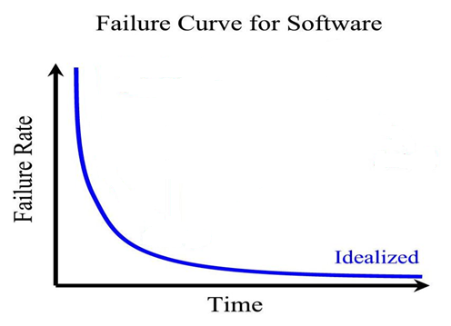
Failure curve for software

Slide 17
Important Points that shows Software does not wear out are-
Software becomes reliable over time instead of wearing out.
It may be retired due to environmental changes, new requirements, new expectations etc.
When a hardware component wears out, it is replaced by a spare part. But, there are no software spare parts.
Hence, software maintenance require more complexity than hardware maintenance.
2. Software is not manufactured, it is developed.
3. Reusability of components.
4. Software is flexible.

